Slide 1

CSE 583
Software Design for Data Scientists Course Introduction & validating software
David Beck^{1,2,3}
Evan Komp², Nels Schimek²
¹eScience Institute
²Chemical Engineering
³Computer Science
University of Washington
September 28, 2023

Slide 2
What's the class about? Who are we?
Instructor introductions
Objectives
Teach how to create and collaborate on data- and computation-intensive research projects
Provide practical software engineering skills for data analysis in research & industry
Elevate coding in academia to the level of technical writing and patents

Slide 3

Evan Komp
AI + Chemistry and Biology
Climate activist
Huge outdoorsperson
Complete lack of fear of heights that might kill me
Email: evankomp+cse583@uw.edu

Slide 4
Nels Schimek

Slide 5
Dave Beck
I’m Dave, not Dr. Beck, or Professor Beck
ChemE/CSE/Environ. Occup. Health Sciences
Use software, ML & AI to design better molecules and understand how others work
Director, Scientific Software Engineering Center
Director of Research, eScience Institute

Slide 6
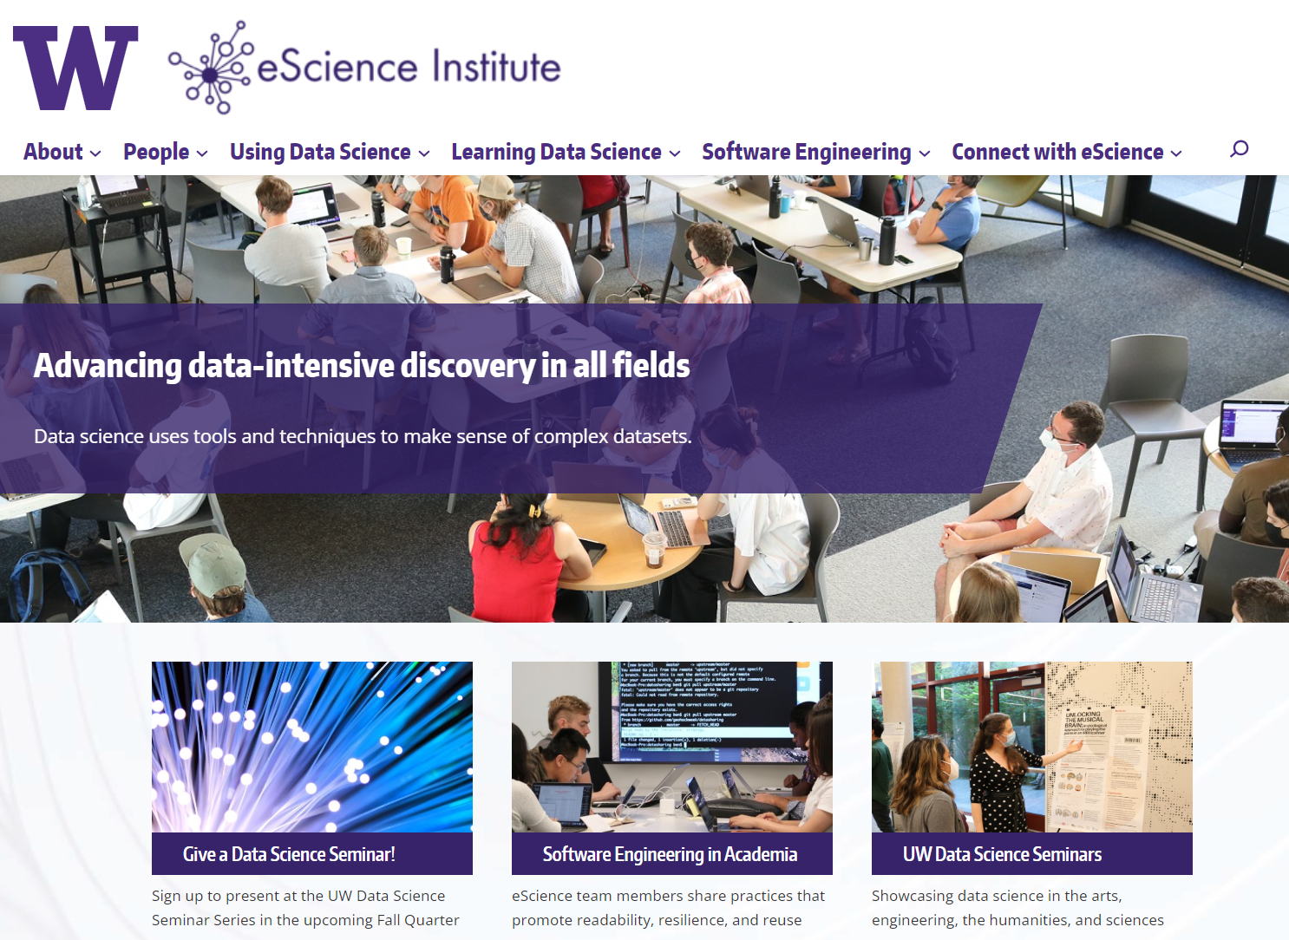

Slide 7
Agenda
Why data science?
Course overview
Validating your software install
7

Slide 8
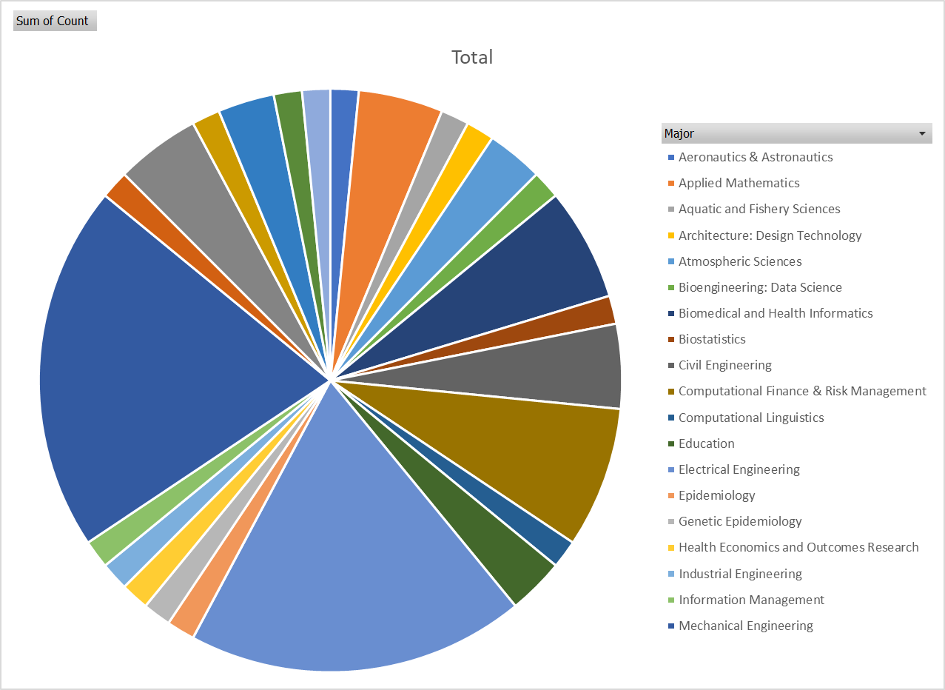
Course Registration by Field of Study

Slide 9
Course Overview
9

Slide 10
Survey Results
Question | Response
Years of programming? | Mostly > 1 yr
Years of python? | < 1 yr
Experience with a text editor | Mostly "Yes"
Comfort with if-statements? | Yes
Comfort with for-statements? | Yes
Comfort with functions? | Mostly "Yes"
Python packages (scipy, pandas, ...) | Mostly "No"
Experience with Jupyter notebooks? | Some
Experience with github? | Very little

Slide 11
What you will learn
Program in Python using the Python scientific stack, including numpy, pandas, and matplotlib.
Search, evaluate, and integrate into a project externally developed Python packages; create your own Python packages.
Develop unit tests that validate important aspects of the project implementation.
Develop software that it can be used by others including: sharing code on GitHub, documentation, installing packages, setup, and running computational studies.
Create technical specifications for what a program should do and how this is accomplished.

Slide 12
Course Structure
http://uwseds.github.io/syllabus.html
Programming basics
Version control, Python, data manipulation
Software development
Debugging, documentation, design, collaboration
Enrichment?
Visualization, machine learning
Software engineering practicum (project)

Slide 13
Programming vs. Software Engineering
Analogy: What is the difference between the following kinds of writing:
Note to yourself
An article in the NY Times
13

Slide 14
Relating Writing to Software
How Learn Skills
Reporter
Writing quality
Content
Structure
Review
SW Eng
Code quality
Features
Design
Testing
Programming course, this class
Freshman English
{
{
Composition & literature classes, professional writer
CS degree, practical collaborative exp., this class
14

Slide 15
Grading
Item | %
Homework (~5 homeworks) | 35
Class participation | 15
Class project | 50
15
Notes:
Describe the importance of the homework and address concerns about rigidity for grad students

Slide 16
Grading
How we grade homework…
You submit homework using GitHub (version control tool) by the due date
We take up to a week to review the homework and give feedback with a GitHub Issue
You have an additional week to revise the homework to address any weaknesses
Your final grade for a homework is given
There is no reason you can’t get 5/5 on all HW
16
Notes:
Describe the importance of the homework and address concerns about rigidity for grad students

Slide 17


Class project overview
Collaborative software engineering experience
Teams of 3 to 4 with 4 being optimal
Prefer teams with diversity
Develop project using version control
17

Slide 18
Class project overview
Collaborative software engineering experience
Design (use cases, component specification)
Documentation (how to, docstrings)
Style (PEP8, pylint)
Coding, testing & milestones
Standup & code reviews
http://uwseds.github.io
18

Slide 19
Project Type 1:
Answer “Research” Questions
Problem statement: Answer two to three questions of business or scientific relevance
Use a Jupyter notebook and supporting python files
Example
Climate Police: Analyze effects of pollution on the planet.
19

Slide 20
Capstone Project Type 2:
Create Reusable Data
Problem statement: Create data repository with tools (e.g., search, visualization, analytics)
Example
Car2Know: Provide car rental data to users of Car2Go (e.g., for planning trips)
20

Slide 21
Project Type 3:
Create a Tool
Problem statement: Solve a problem common to many users
Don’t re-invent the wheel
Example
BioReactor Data Logging – Monitor and publish data from BioReactor experiments
21

Slide 22
Getting Started
Students present statements of interest
Gather with like minded students
Verify the project idea
Size the effort

Slide 23
Things to Think About
Topics of interest
Is there an unmet need (i.e. no code already exists)?
Is there only commercial software available for a task?
What is the potential user base?
Data you have access to NOW
How much you’ve used the data
Code you have to access the data
How clean the data are
23

Slide 24
Verify the Project Idea
Is there an unmet need (i.e. no code already exists)?
Clarity about the project type?
Consensus on the problem being solved.
Do you have data that can solve the problem?
24

Slide 25
More on the Data
At least two non-trivial data sets
Data need to be combined, joined, merged, etc. to answer the scientific questions
Have access to the data NOW!
25

Slide 26
Some Public Data
http://drugbank.ca
http://toxnet.nlm.nih.gov
https://data.seattle.gov/Transportation/Traffic-Flow-Counts/7svg-ds5z
https://www.divvybikes.com/data
http://www.nyc.gov/html/tlc/html/about/trip_record_data.shtml
https://www.kaggle.com
Pronto bike data
American Fact Finder Data
European union data (World bank)
Russian federation data (World bank)
China data (World bank)
26

Slide 27
Data! Data! Data!
At least two non-trivial data sets
Data need to be combined, joined, merged, etc.
Think about your data NOW!
27

Slide 28
Project Ideation
Over the first few weeks
What areas are you interested in? E.g. social good or a job demo.
What data are available in that space?
What tools already exist in that space?
What type of project is this? (answer research question, create reusable data, create a tool, other?)
Volunteer to give a one slide, 5 minute project idea pitch at the start of class!
28

Slide 29
Course Web Page
http://uwseds.github.io
29

